Slide 1
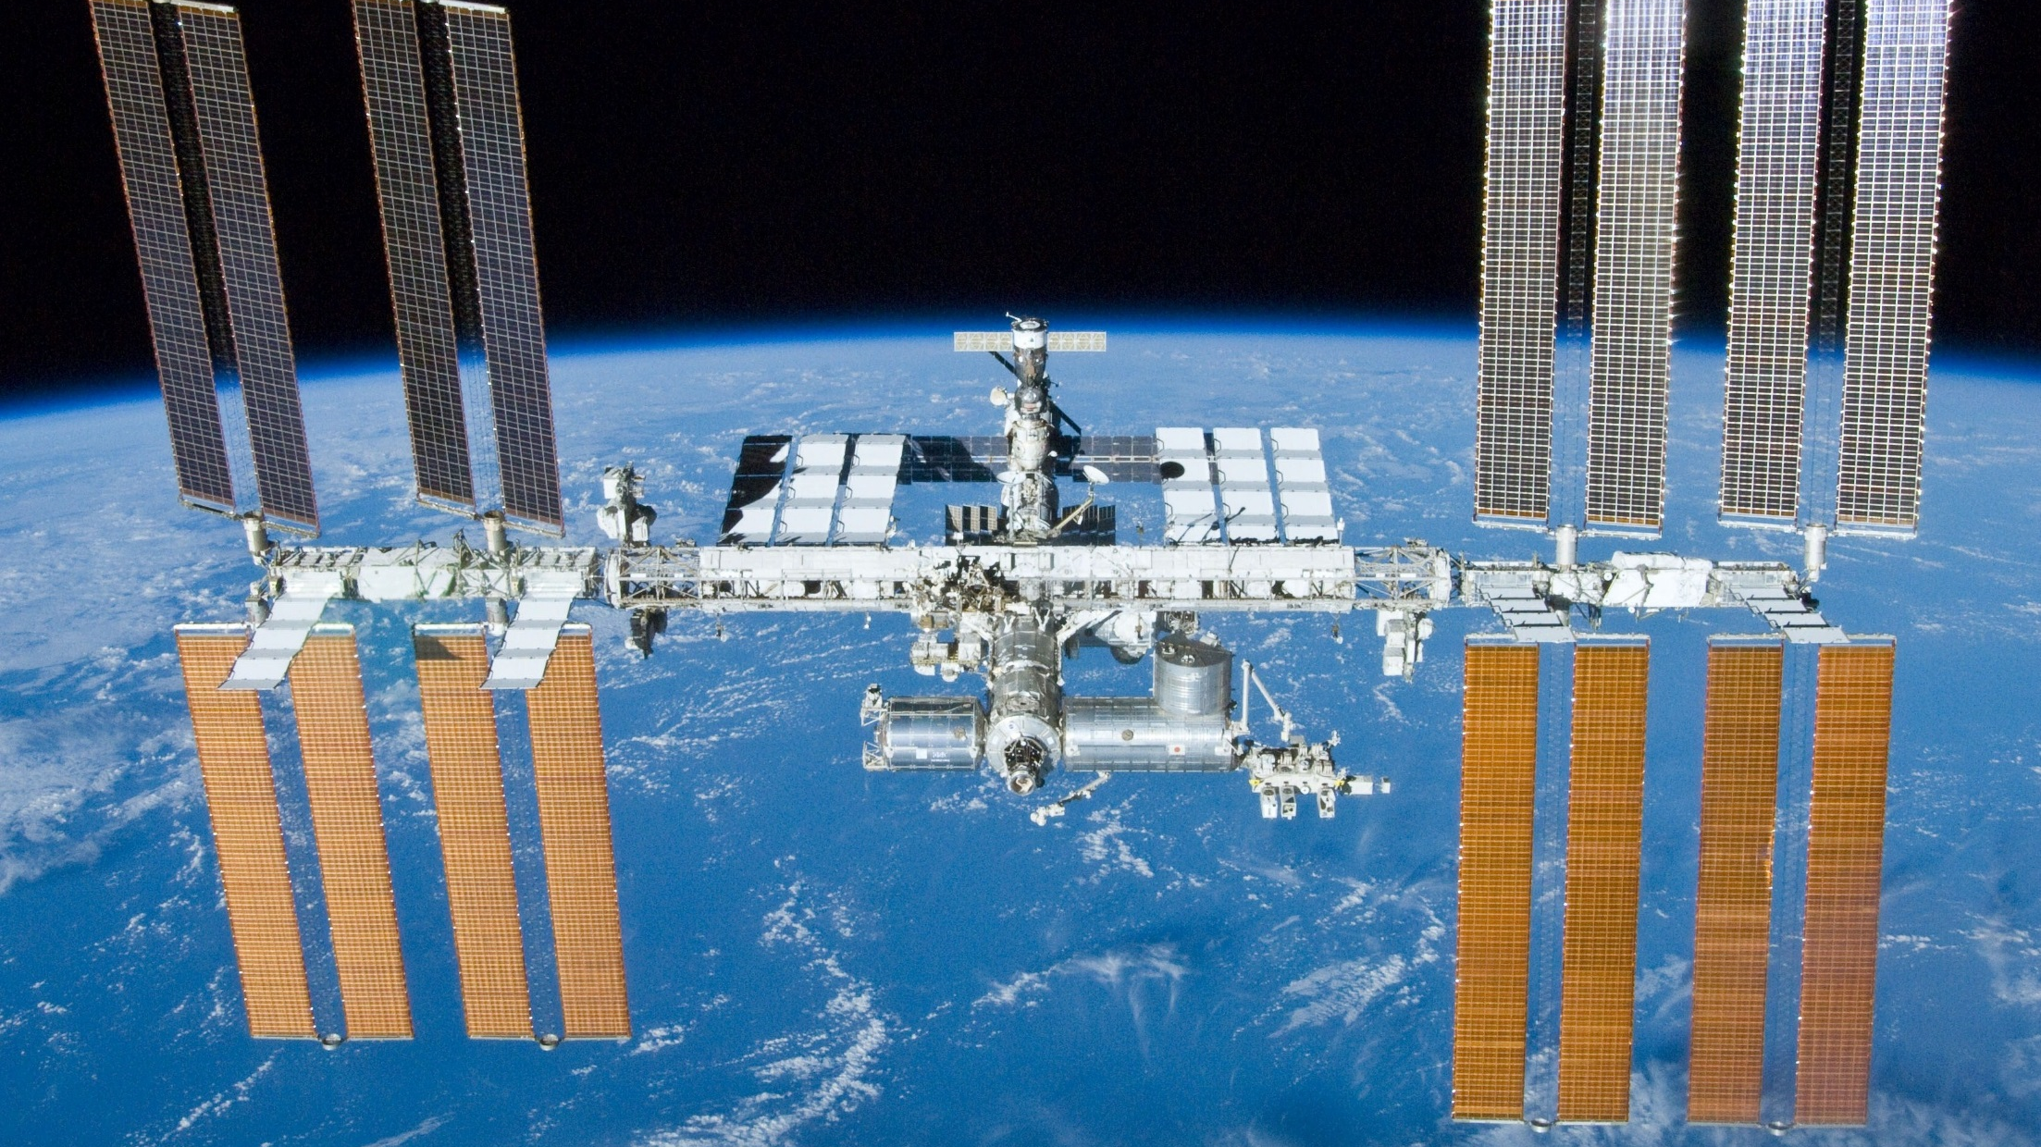
BARRIOS PRESENTS
An Introduction to the International Space Station
Ginger Kerrick Davis
Devin Vyain

Slide 2
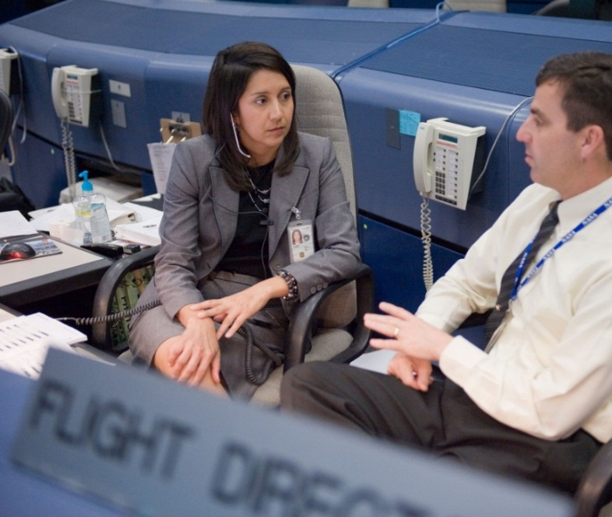
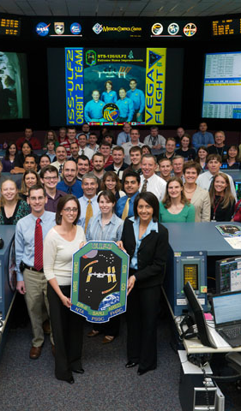
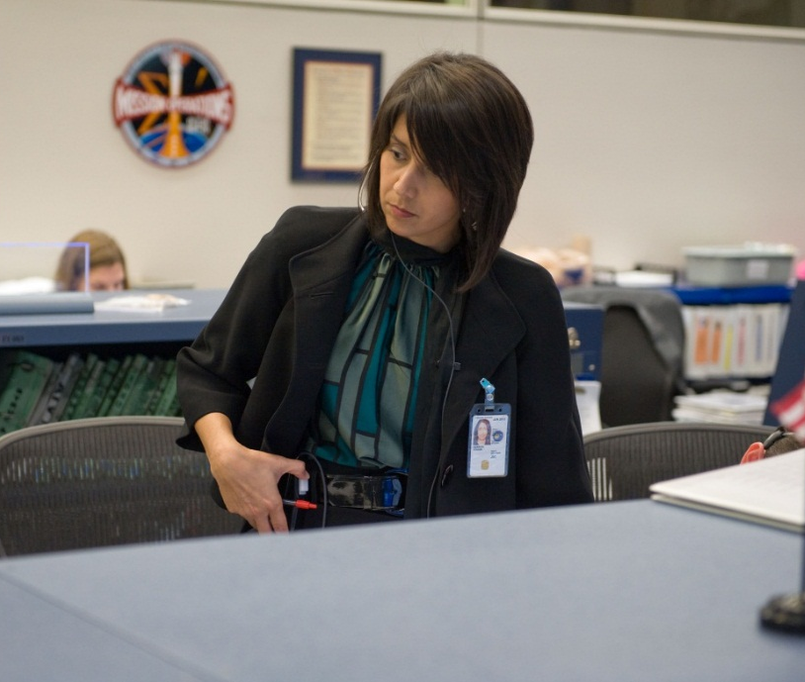
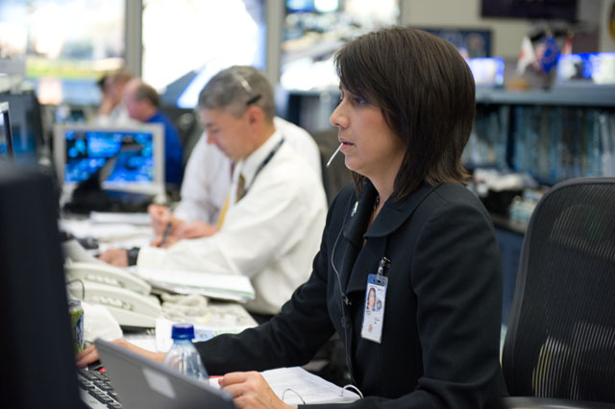
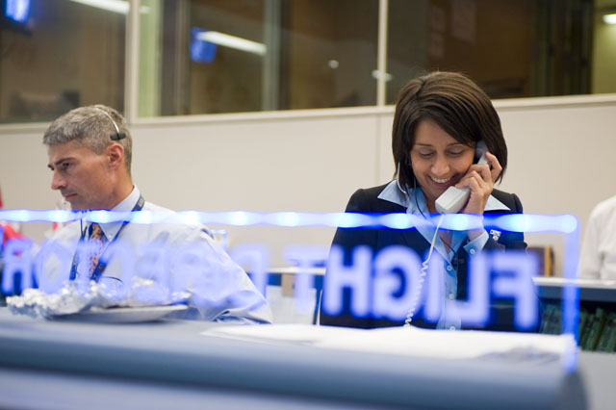

Slide 3
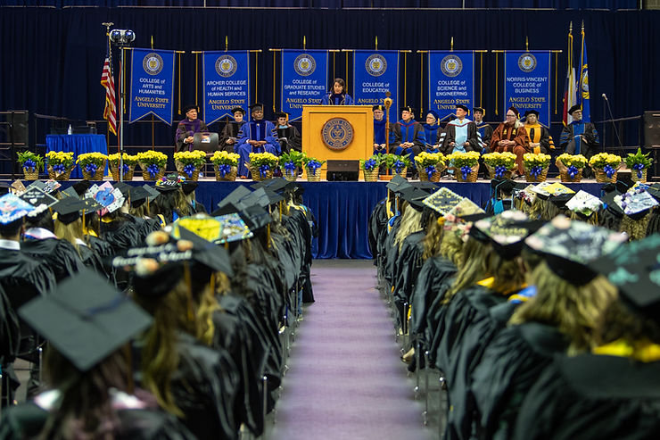
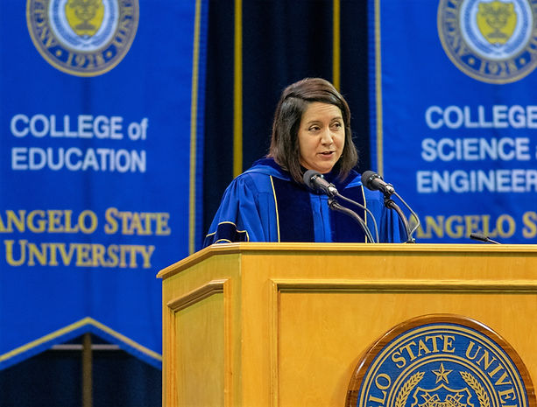

Slide 4
Outline
Overview of the International Space Station (ISS)
Overview of Crew/Cargo Transportation Vehicles
Soyuz
SpaceX Crew Dragon
Progress
SpaceX Cargo Dragon
Northrup Grumman Cargo Cygnus
Japanese Space Agency HTV Cargo Vehicle
Intro to Flight Planning

Slide 5

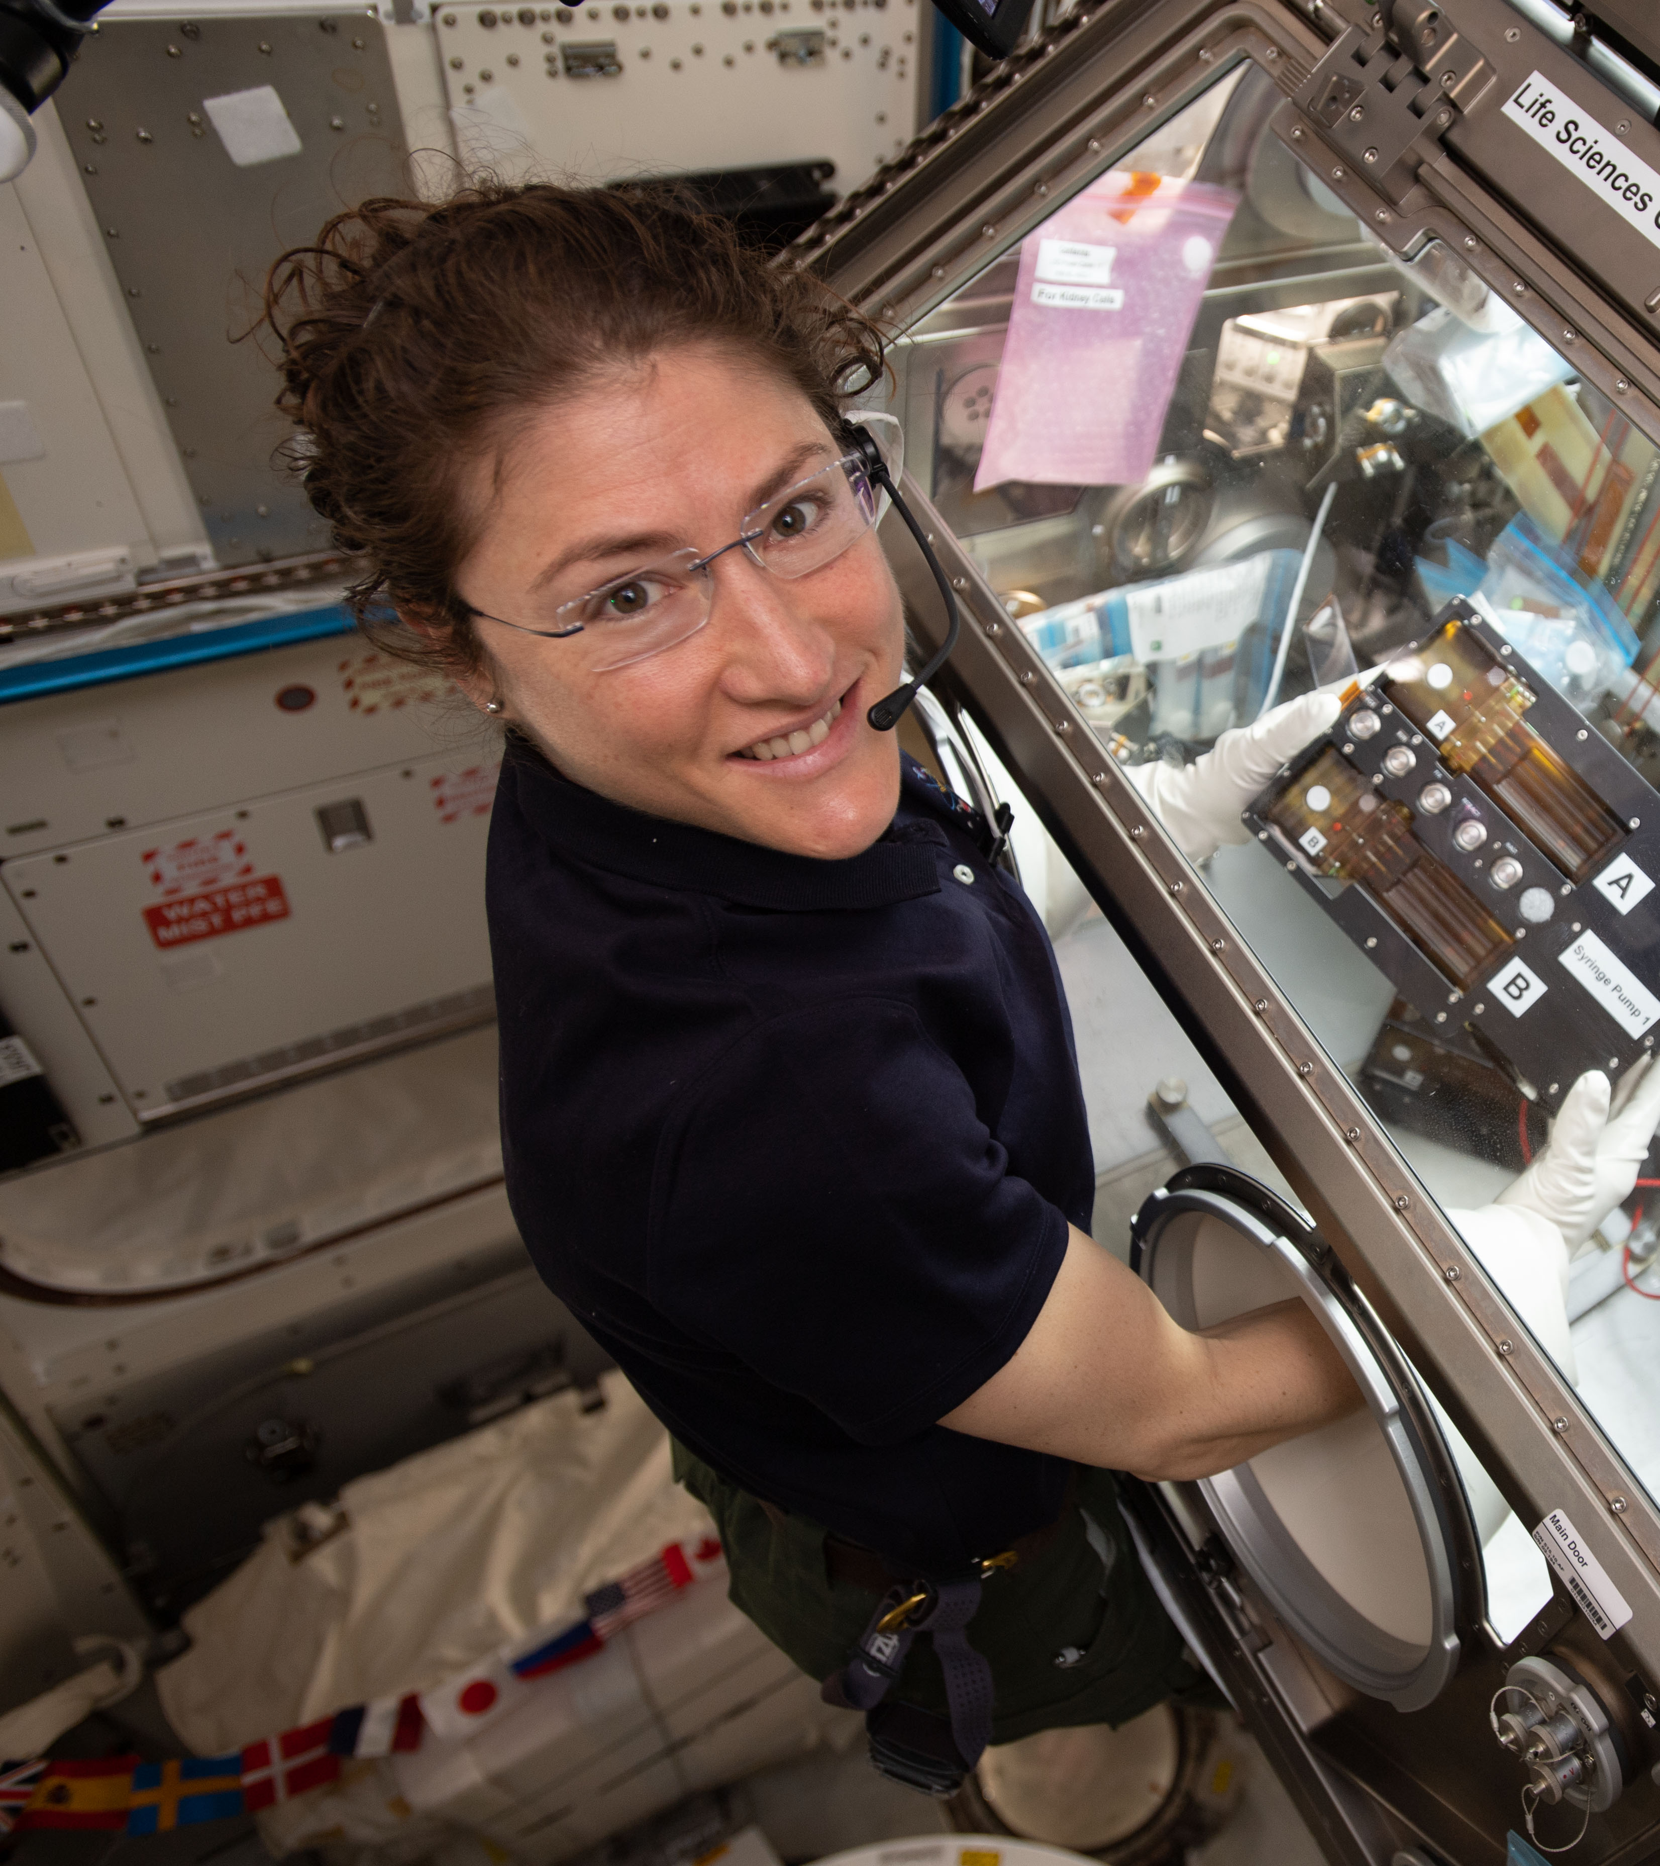
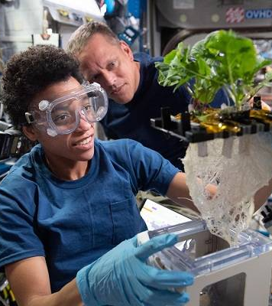
ISS Purpose
The International Space Station is a multi-national orbiting laboratory that enables researchers from around the world to take advantage of microgravity, exposure to space, and a unique perspective of Earth to conduct groundbreaking experiments

Slide 6
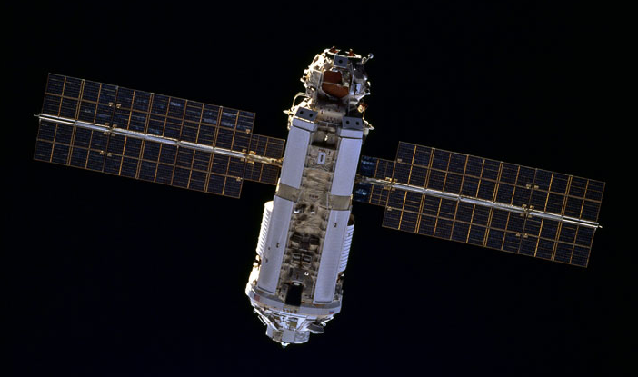
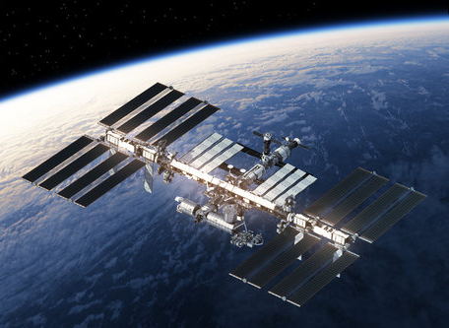
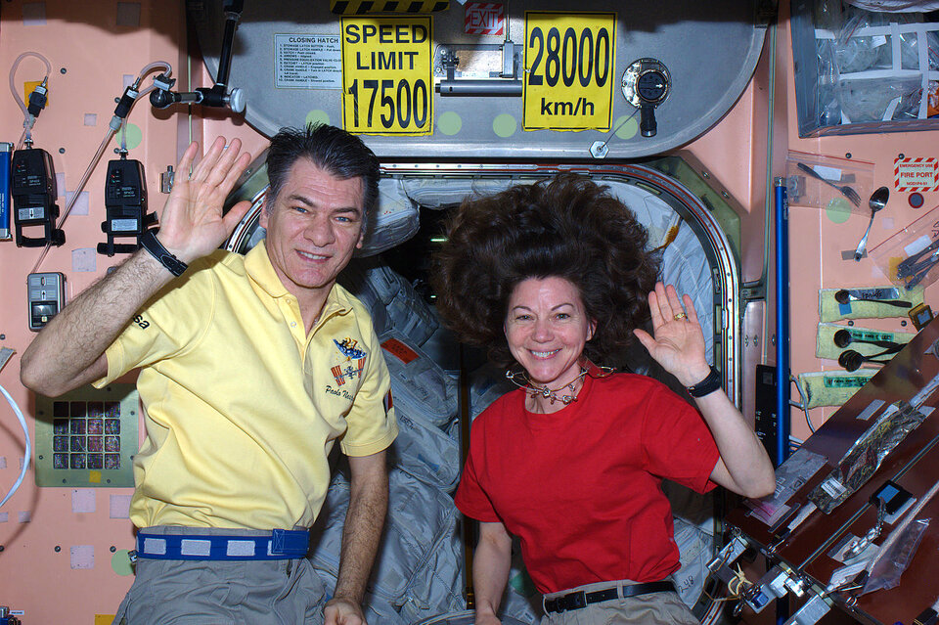
ISS Interesting Facts
The first element, FGB, launched in 1998
ISS orbits ~250 miles above Earth …
… at a speed of 17,500 mph
… orbiting Earth every ~90 minutes
… with 16 sunrises/sunsets each day!

Slide 7
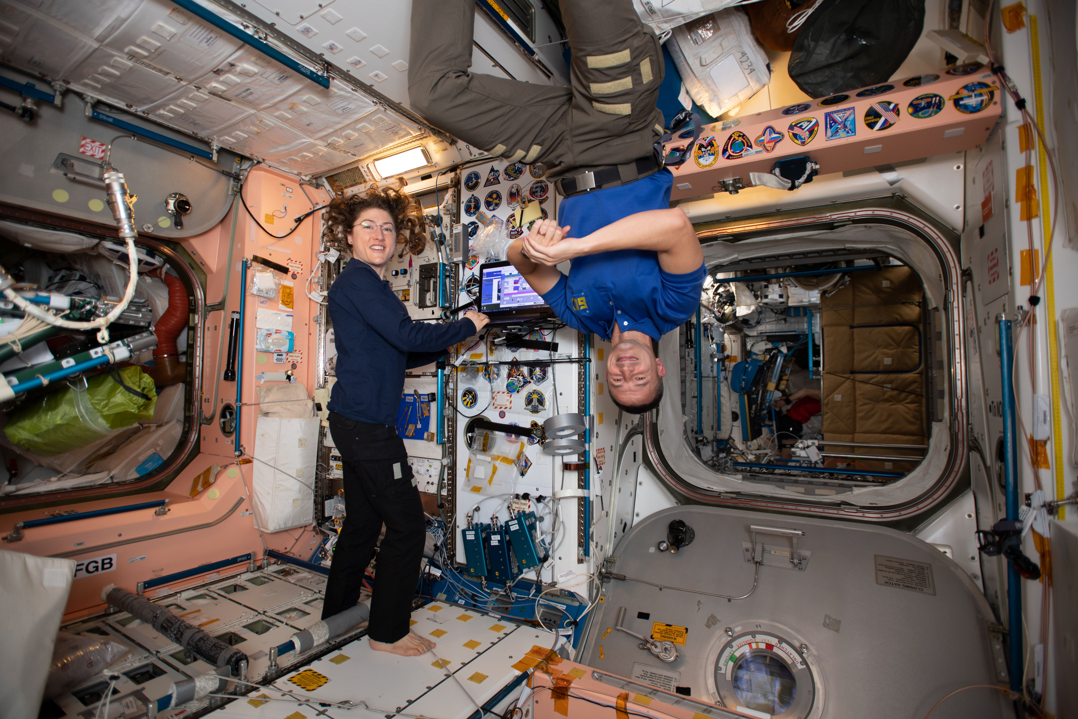
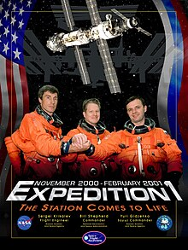
ISS Interesting Facts
Crews have lived on ISS continuously since November 2000
ISS living/working space is like a 6-bedroom house (13,696 cubic feet)
Crews have compared it to living in the cabin of a Boeing 747 jumbo jet

Slide 8
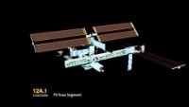
International Space Station Assembly (1998 – 2011)

Slide 9
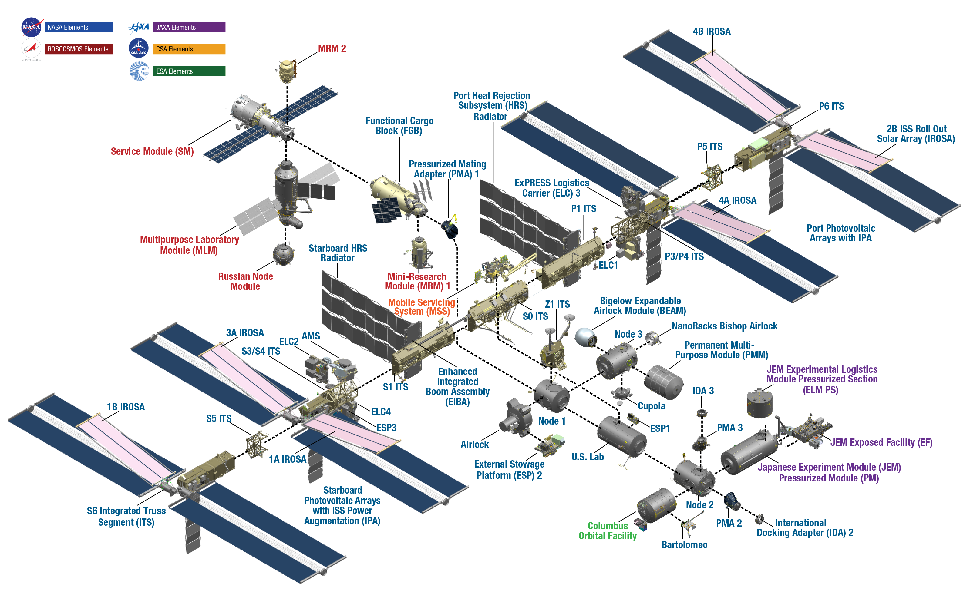
ISS Science and Research
The International Space Station
Purpose
As…..

Slide 10
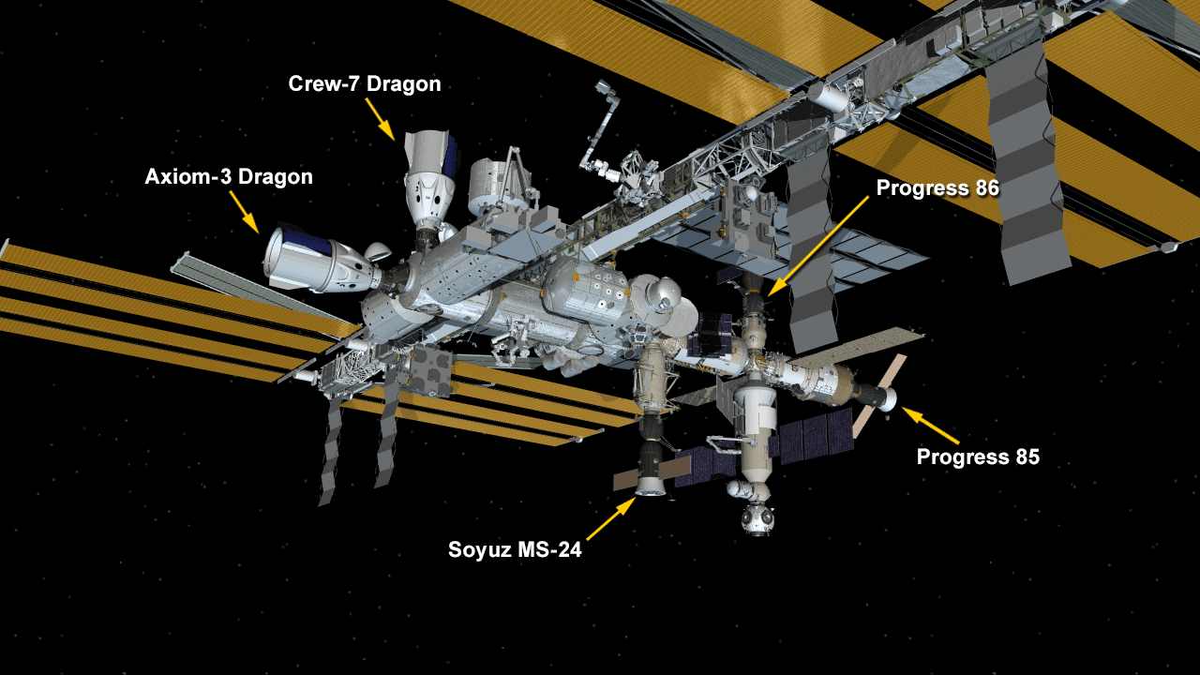
ISS Parking Spaces
There are 8 parking spaces on the ISS:
4 Russian
4 US
Must accommodate both Crew and Cargo vehicles
Unoccupied
Unoccupied

Slide 11
ISS Parking Spaces
There are 8 parking spaces on the ISS:
4 Russian
4 US
Must accommodate both Crew and Cargo vehicles
Unoccupied
Unoccupied

Slide 12
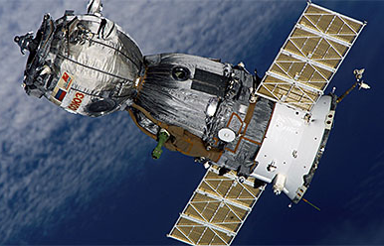
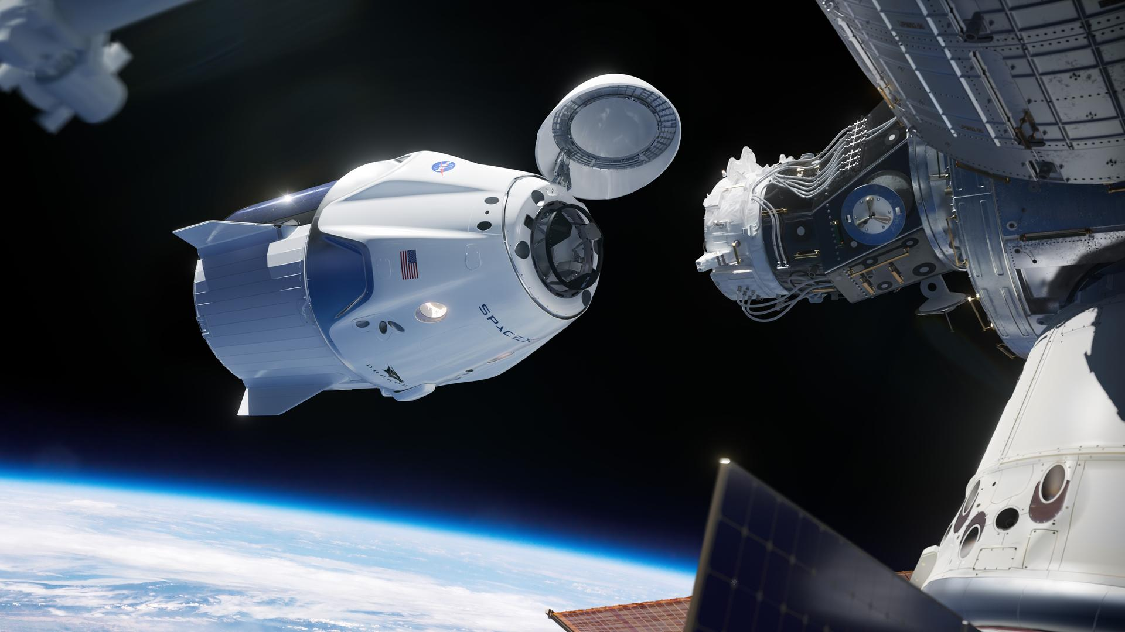
ISS Visiting Vehicles - Crew
RUSSIAN SOYUZ
3 Crew: 2 Russian, 1 American
Duration: ~ 180 days
SPACEX CREW DRAGON
4 Crew: 3 American/Other International, 1 Russian
Duration: ~ 180 days

Slide 13

ISS Visiting Vehicles – Private Crew (Axiom)
Plans to construct the world’s first commercial space station and next generation spacesuits
Currently on contract with NASA for private crew missions to the ISS
SPACEX CREW DRAGON (AXIOM)
4 Crew: 1 American Retired NASA Astronaut, 3 Other
Duration: ~ 14 days

Slide 14
ISS Parking Spaces
There are 8 parking spaces on the ISS:
4 Russian
4 US
Must accommodate both Crew and Cargo vehicles
Unoccupied
Unoccupied

Slide 15
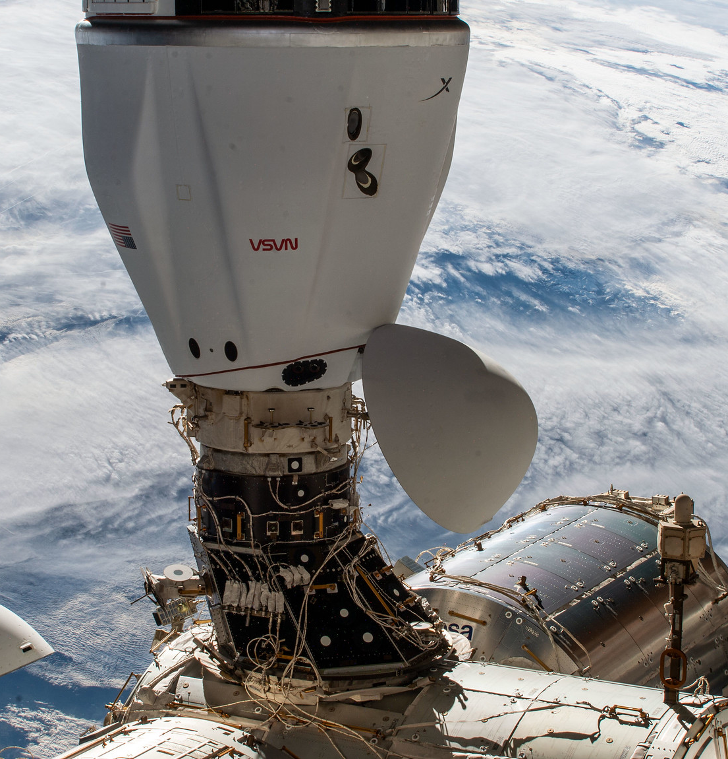
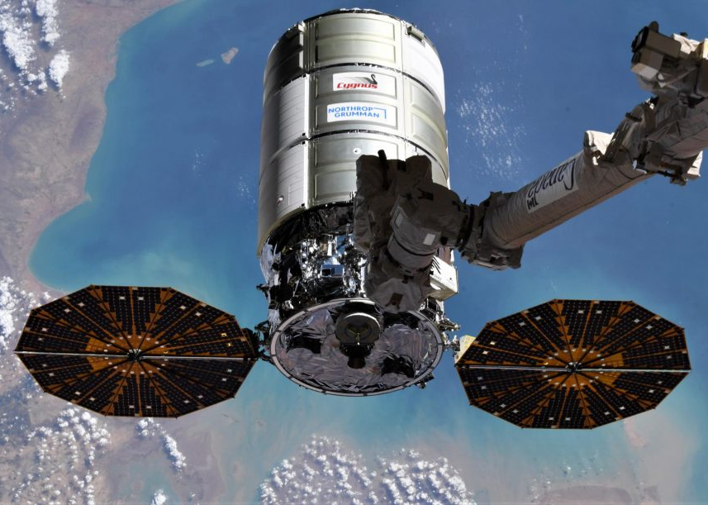
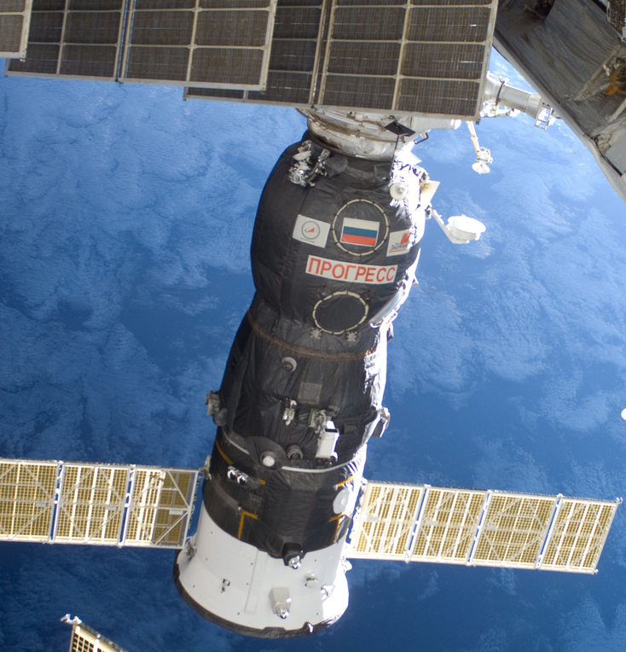
Current ISS Visiting Vehicles - Cargo
SPACEX CARGO DRAGON
Capacity: ~7,000 lbs
Duration: ~30 days
Return Capability: Y
NORTHROP GRUMMAN CYGNUS
Capacity: ~ 8,200 lbs
Duration: ~3-5 months
Return Capability: N
PROGRESS
Capacity: ~ 5,400 lbs
Duration: ~4-8 months
Return Capability: N

Slide 16
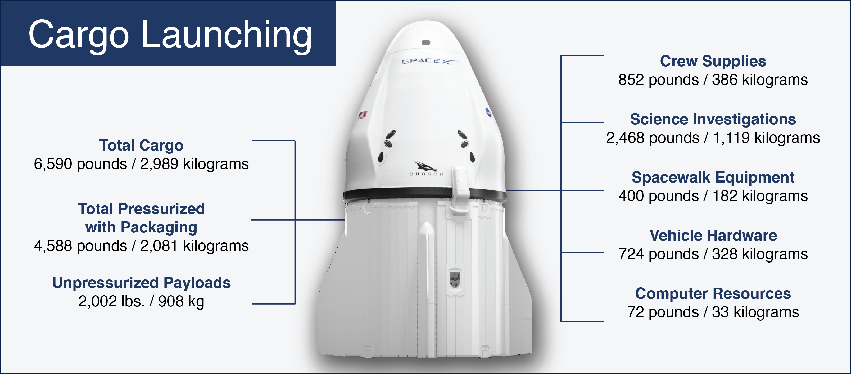
ISS Visiting Vehicles – SpaceX Cargo Dragon Example

Slide 17
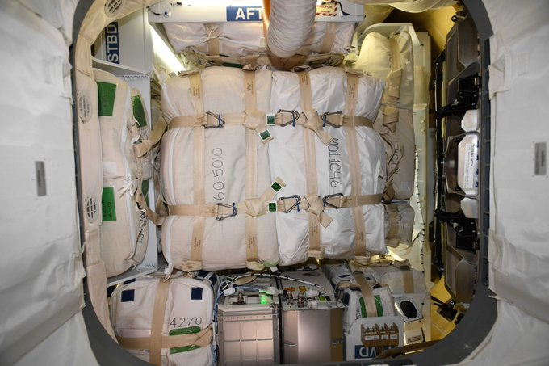
ISS Visiting Vehicles – SpaceX Cargo Dragon Example
Bags packed for return in SpaceX Cargo Vehicle

Slide 18
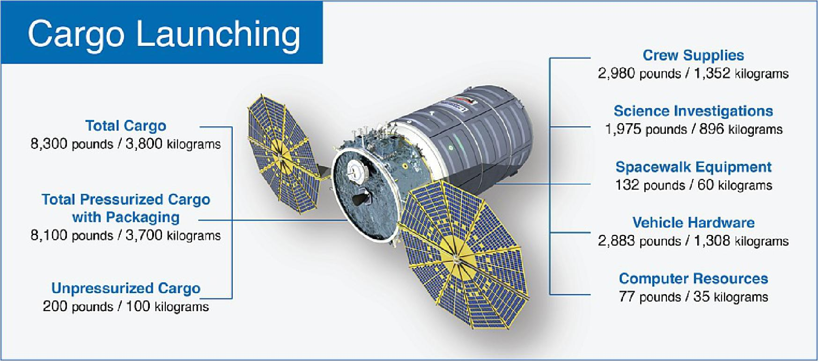
ISS Visiting Vehicles – Northrop Grumman Cygnus Example

Slide 19
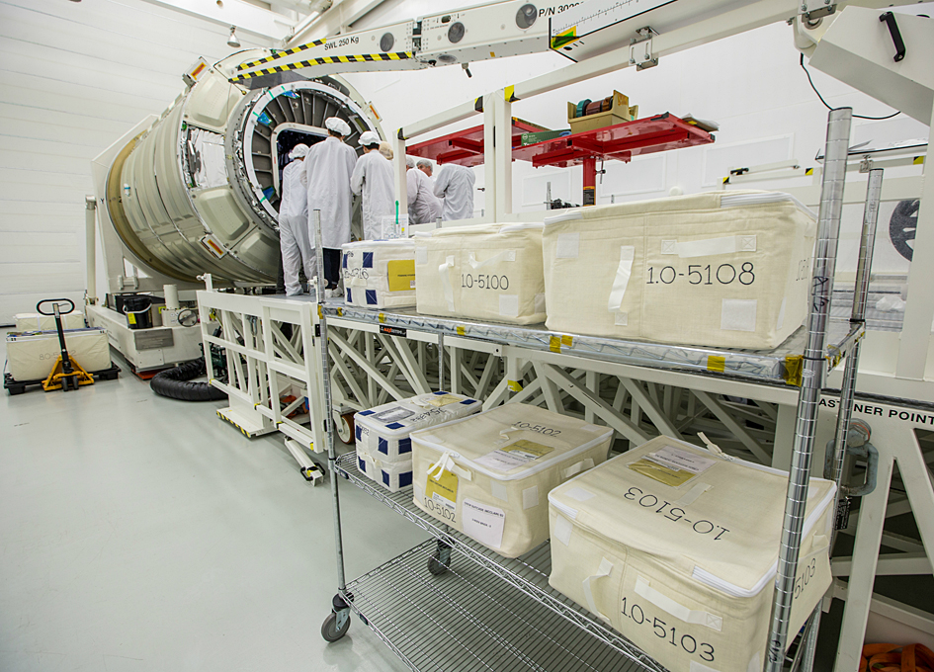
ISS Visiting Vehicles – Northrop Grumman Cygnus Example
Loading supplies into the Cygnus Cargo Vehicle

Slide 20
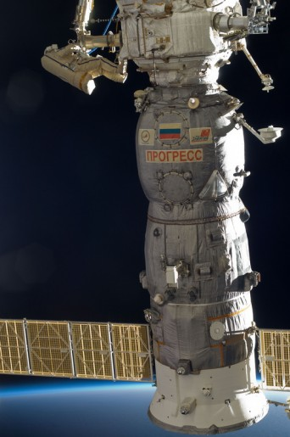
ISS Visiting Vehicles – Progress Capacity
Cargo Launching
Total Cargo
5,400 pounds, 2,450 kilograms
Dry Cargo
4,000 pounds, 1,800 kilograms
Air/Oxygen
110 pounds, 50 kilograms
Water
930 pounds, 420 kilograms

Slide 21
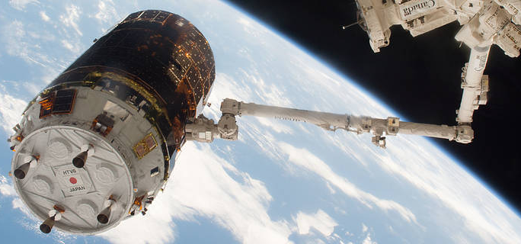
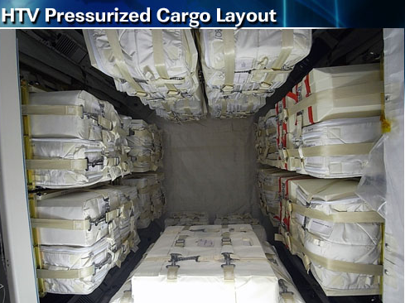
Previous ISS Visiting Vehicles - Cargo
Japanese Aerospace Exploration Agency (JAXA) H-II Transfer Vehicle (HTV)
Capacity: ~ 12,000 lbs
Duration: ~2-3 months
Return Capability: N

Slide 22
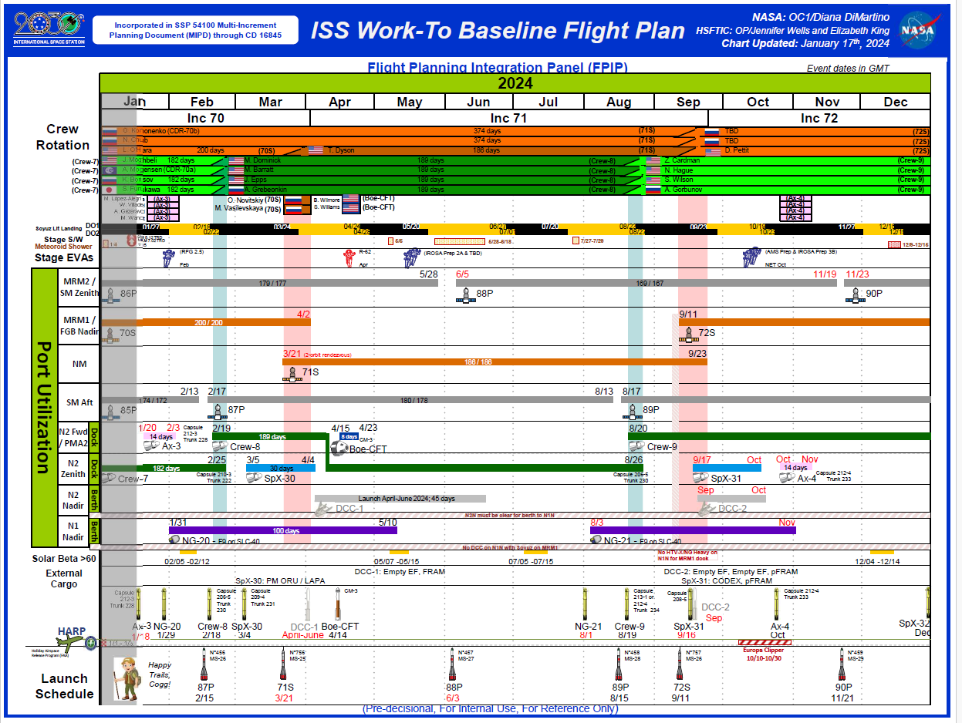
ISS Flight Plan

Slide 23
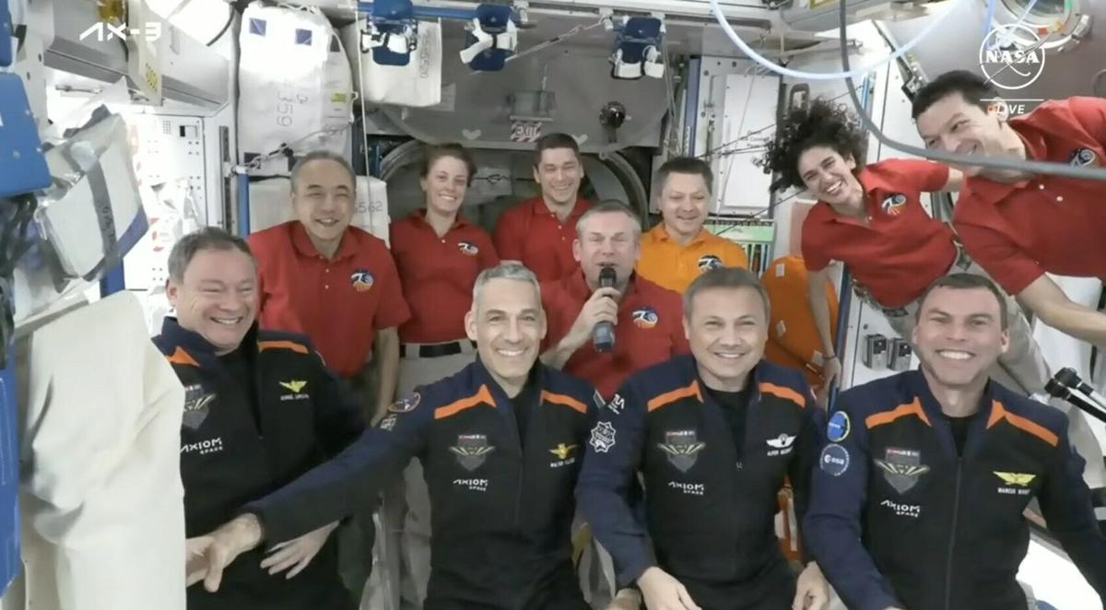
ISS Crew

Slide 24
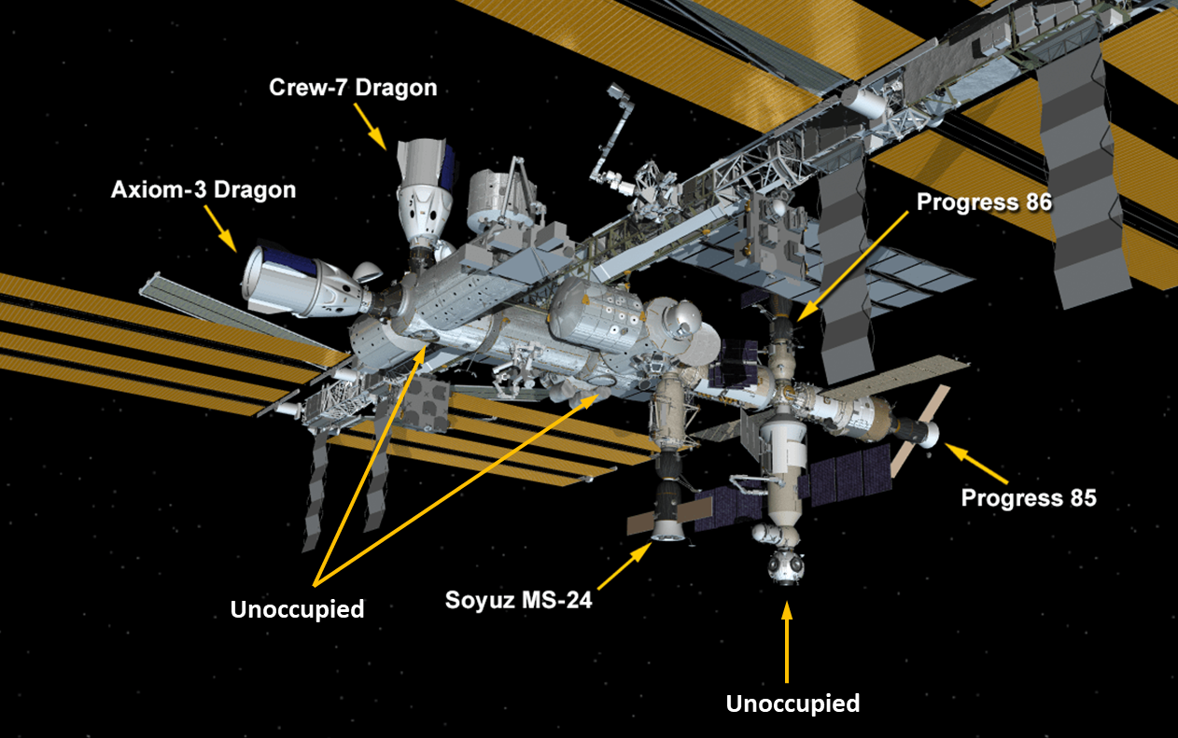
8 Parking Spots

Slide 25
RUSSIAN SOYUZ
3 Crew: 2 Russian, 1 American
Duration: ~ 180 days

Slide 26
SPACEX CREW DRAGON
4 Crew: 3 American/Other International, 1 Russian
Duration: ~ 180 days

Slide 27
SPACEX CREW DRAGON (AXIOM)
4 Crew: 1 American Retired NASA Astronaut, 3 Other
Duration: ~ 14 days

Slide 28
SPACEX CARGO DRAGON
Capacity: ~7,000 lbs
Duration: ~30 days
Return Capability: Y

Slide 29
NORTHROP GRUMMAN CYGNUS
Capacity: ~ 8,200 lbs
Duration: ~3-5 months
Return Capability: N

Slide 30
PROGRESS
Capacity: ~ 5,400 lbs
Duration: ~4-8 months
Return Capability: N

Slide 31
Review
Overview of the International Space Station (ISS)
Overview of Crew/Cargo Transportation Vehicles
Soyuz
SpaceX Crew Dragon
Progress
SpaceX Cargo Dragon
Northrup Grumman Cargo Cygnus
Japanese Space Agency HTV Cargo Vehicle
Intro to Flight Planning

Slide 32
THANK YOU!
WE ARE EXCITED TO SEE WHAT NEW APPROACHES YOU RECOMMEND!

Slide 33
THANK YOU! WE ARE EXCITED TO WORK WITH YOU!

